Slide 1
Graphene

Slide 2
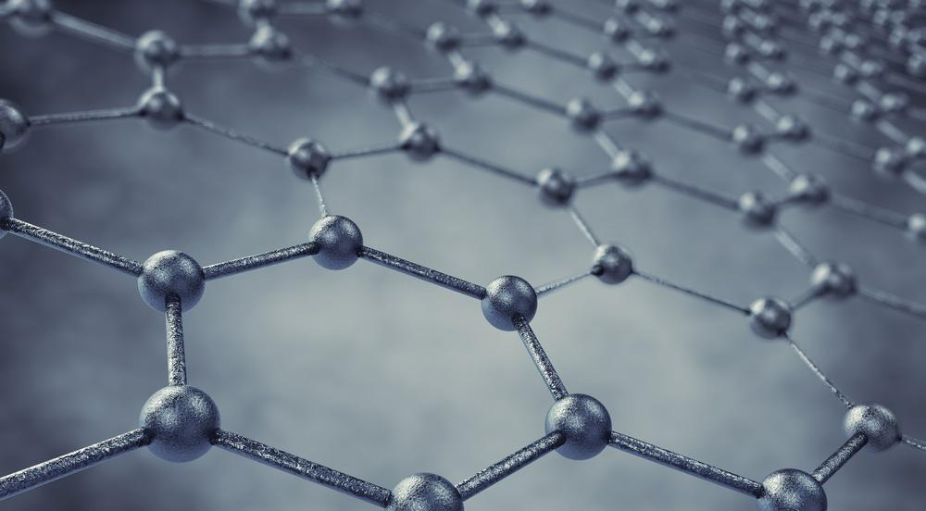
What is Graphene?
Graphene is a single layer of carbon atoms formed in a hexagonal honeycomb lattice.
Notes:
Graphene is a single layer of carbon atoms formed is a hexagonal honeycomb lattice. Carbon can exist in many physical forms called allotropes, and graphene is one of the allotropes of carbon. Other allotropes of carbon that you may be familiar of are diamond and charcoal.

Slide 3
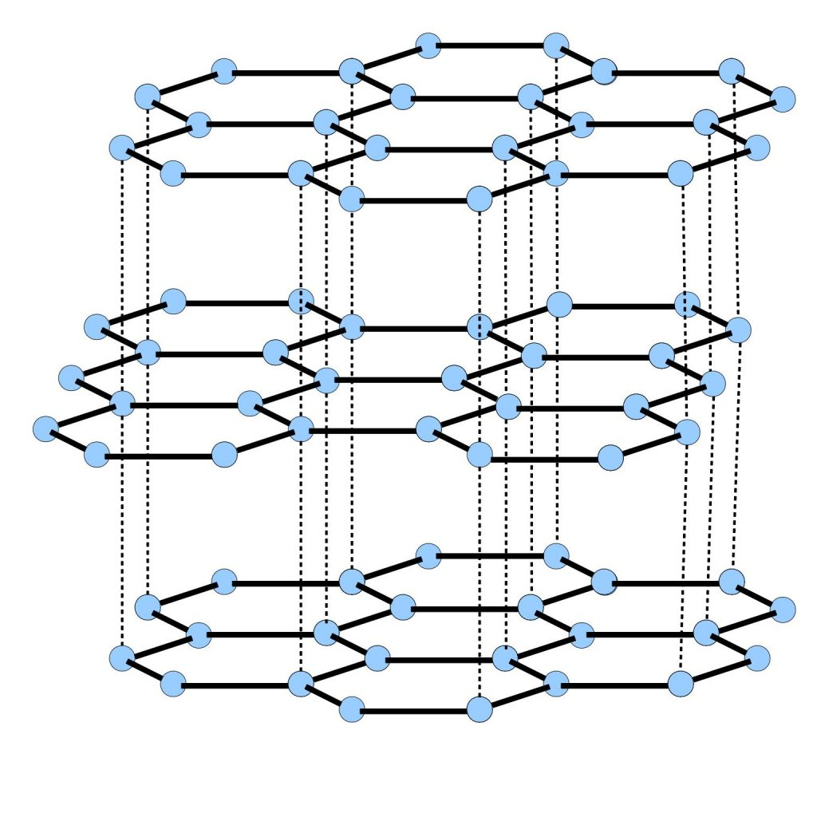
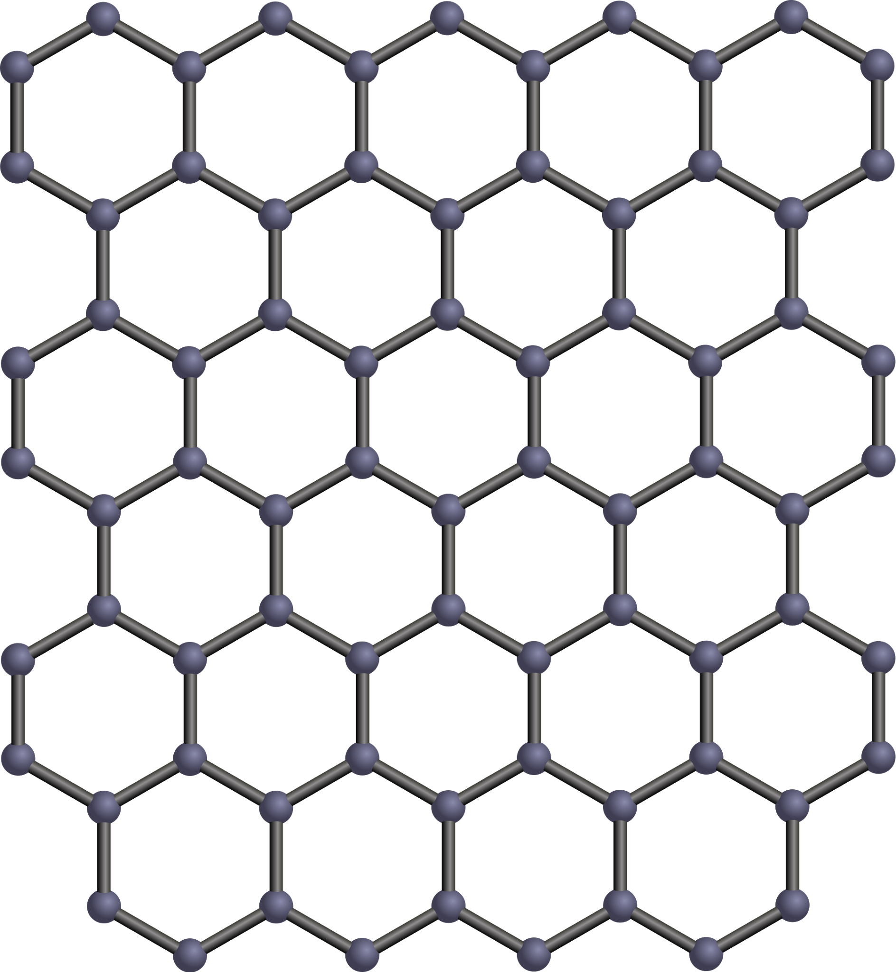
Graphene Vs. Graphite
Notes:
You might be thinking that graphene sounds similar to graphite, which is the the “lead” in your pencils. Graphite is actually many layers of graphene. (Demonstrate)

Slide 4
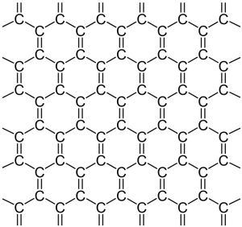
Structure
of
Graphene
Notes:
(Demonstrate)

Slide 5
Strengths of Graphene
thinnest compound known to man at one atom thick
lightest material known (1 square meter weighs around 0.77 milligrams)
strongest compound discovered (between 100-300 times stronger than steel)
best conductor of heat at room temperature
best conductor of electricity known

Slide 6
Uses
Strengthen body armour due to being extremely lightweight, chemically inert, and flexible as well as its large surface area and strength
Can be used for batteries, being 5x more effective compared to lithium batteries. Increased capacity, recharge rate, and longevity due to it being a potent conductor of electrical and thermal energy
Can be used in paint as a barrier against corrosion
Can be potentially implemented into clothing and cars
Can be used for filtration

Slide 7
Price of Graphene
The price of graphene in 2010 was 1000 euros per cm squared. The thought was that graphene would become cheaper in a matter of years, just like how carbon fiber was started to be used 30-40 years after it was discovered. From then to today, the prices of graphene is gradually dropping. We may see more graphene being applied to products since now it is cheaper.

Slide 8
Works Cited
Images
https://www.extremetech.com/extreme/211437-extremetech-explains-what-is-graphene
http://www.quirkyscience.com/graphene-properties/
http://www.urbanara.co.uk/journal/buying-guide/beeswax/
https://www.redbubble.com/people/freshmemes/works/24074333-barry-b-benson-from-the-bee-movie?p=throw-pillow
https://steemit.com/science/@scisteem/one-planet-is-not-enough-graphene-is-heading-to-space
http://www.electroboom.com/?p=835

Slide 9
Works Cited
Information
https://www.graphenea.com/pages/graphene#.WleURrynHIU

